Slide 1
Chapter 4--Linear Discriminant Analysis
Introduction of Linear Discriminant Analysis (LDA)
Steps of Linear Discriminant Analysis
Example of Linear Discriminant Analysis
Perceptron

Slide 2

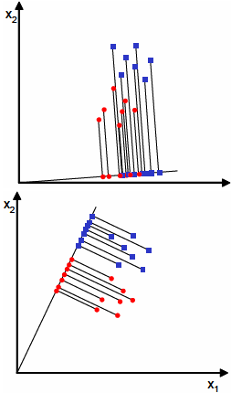
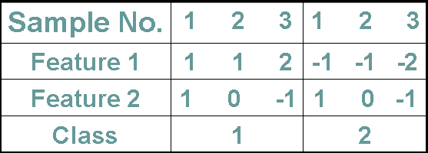

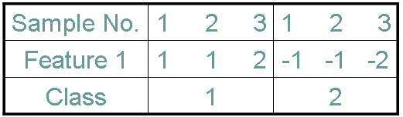
4.1 Linear Discriminant Analysis

Slide 3
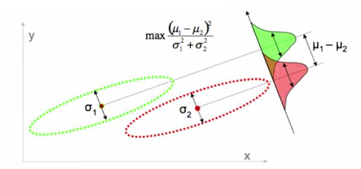
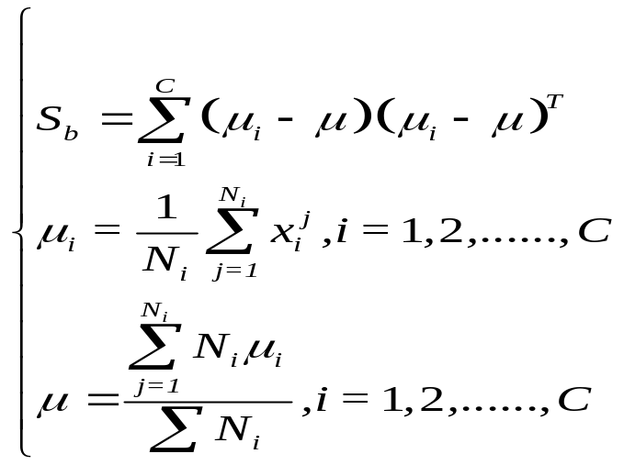
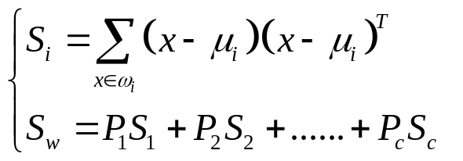
4.1 Linear Discriminant Analysis
Between-class scatter matrix S_{B} and within-class scatter matrix S_{W}

Slide 4

4.1 Linear Discriminant Analysis
The objective of LDA is to perform dimensionality reduction while preserving as much of the class discriminatory information as possible.
Assume we have a set of D-dimensional samples {x(1), x(2), …, x(N)}. We seek to obtain a scalar y by projecting the samples x onto a line
Of all the possible lines we would like to select the one that maximizes the separability of the scalars.

Slide 5
Chapter 4--Linear Discriminant Analysis
Introduction of Linear Discriminant Analysis (LDA)
Steps of Linear Discriminant Analysis
Example of Linear Discriminant Analysis
Perceptron

Slide 6

4.2 Steps of Linear Discriminant Analysis
First step: Computing the mean of each class:

Slide 7
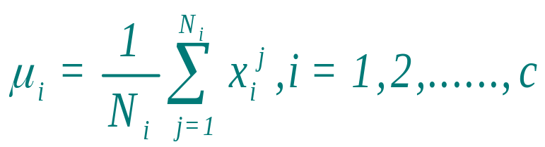
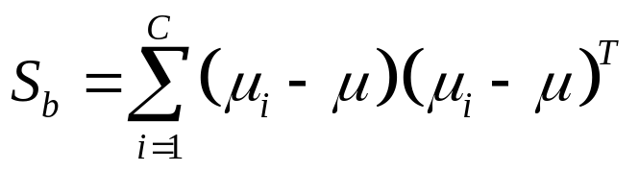

4.2 Steps of Linear Discriminant Analysis
First step: Computing the mean of each class:
Second step: Computing the between-class scatter matrix S_{b} and the within-class scatter matrix S_{w}

Slide 8
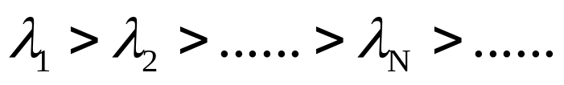

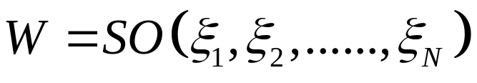
4.2 Steps of Linear Discriminant Analysis
Third step: Completing the Singular value decomposition of S_{W}⁻¹S_{B} to obtain the standardized orthogonal transformation matrix
Aligning the eigenvalues​​ λ of S_{t} in descending order:
Keeping the top N largest eigenvalues ​​and the corresponding eigenvectors:
Using the selected eigenvectors constructing the standardized orthogonal transformation matrix W.

Slide 9

4.2 Steps of Linear Discriminant Analysis
Third step: Completing the Singular value decomposition of S_{W}⁻¹S_{B} to obtain the standardized orthogonal transformation matrix
Fourh step: Obtaining the LAD projection

Slide 10
Chapter 4--Linear Discriminant Analysis
Introduction of Linear Discriminant Analysis (LDA)
Steps of Linear Discriminant Analysis
Example of Linear Discriminant Analysis
Perceptron

Slide 11
4.3 Example of Linear Discriminant Analysis
Compute the Linear Discriminant projection for the following two-dimensional dataset.
Sample No. | 1 2 3 4 | 1 2 3
Feature 1 | 4 1 2 1 | 1 3 2
Feature 2 | 2 4 2 4 | 5 4 3
Class | 1 | 2

Slide 12

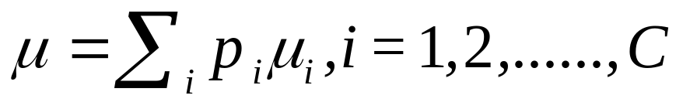
First step: Computing the mean of each class
Sample No. | 1 2 3 4 | 1 2 3
Feature 1 | 4 1 2 1 | 1 3 2
Feature 2 | 2 4 2 4 | 5 4 3
Class | 1 | 2

Slide 13
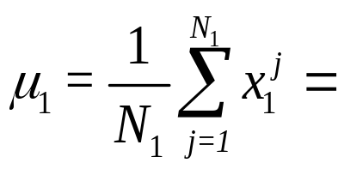
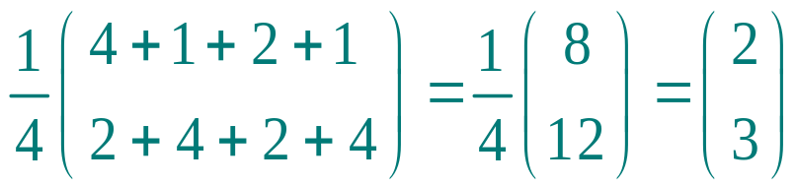
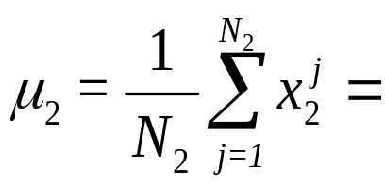
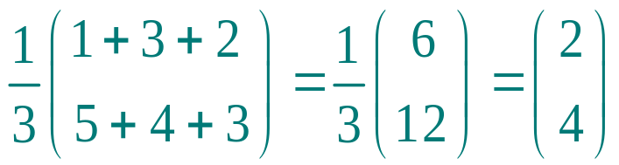
First step: Computing the mean of each class
Sample No. | 1 2 3 4 | 1 2 3
Feature 1 | 4 1 2 1 | 1 3 2
Feature 2 | 2 4 2 4 | 5 4 3
Class | 1 | 2

Slide 14
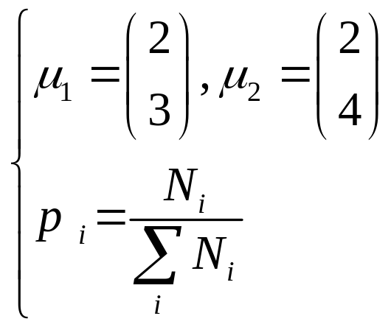
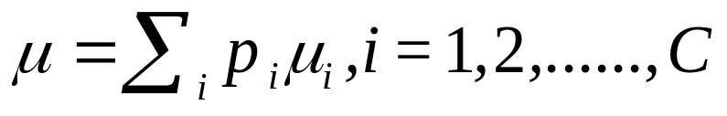
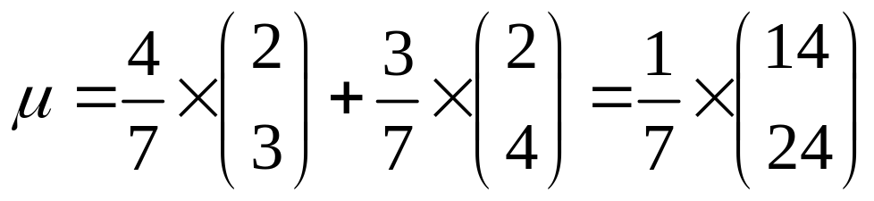
First step: Computing the mean of each class
Sample No. | 1 2 3 4 | 1 2 3
Feature 1 | 4 1 2 1 | 1 3 2
Feature 2 | 2 4 2 4 | 5 4 3
Class | 1 | 2

Slide 15
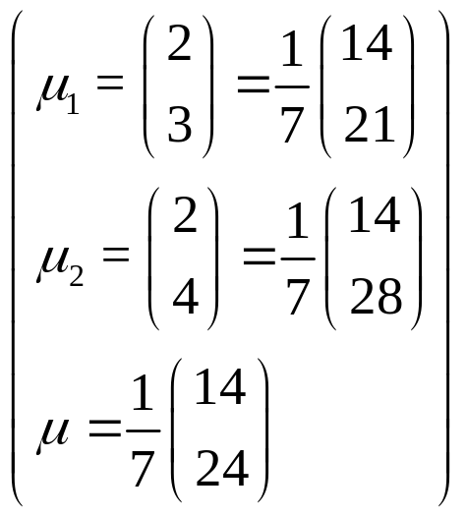
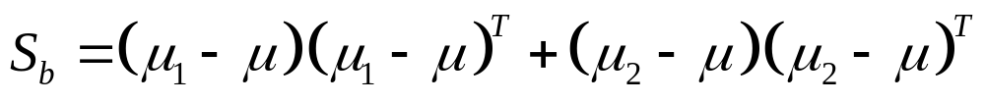
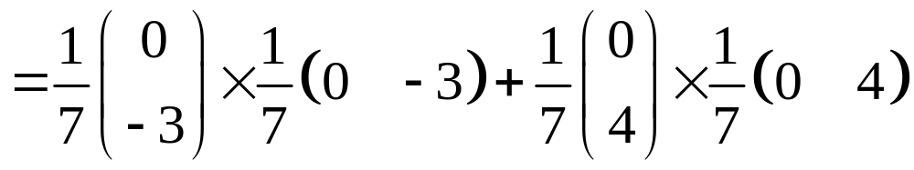
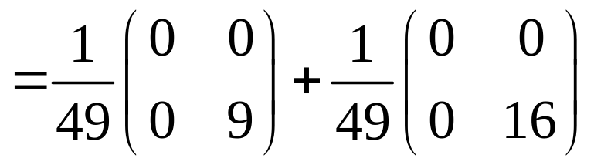
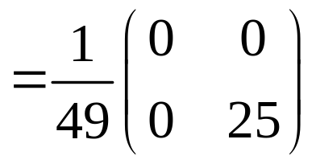
Second step: Computing the between-class scatter matrix S_{B}
Sample No. | 1 2 3 4 | 1 2 3
Feature 1 | 4 1 2 1 | 1 3 2
Feature 2 | 2 4 2 4 | 5 4 3
Class | 1 | 2

Slide 16
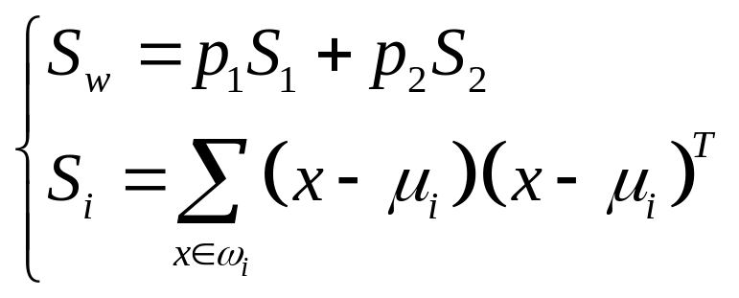
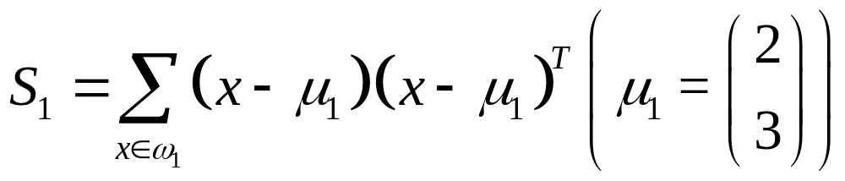
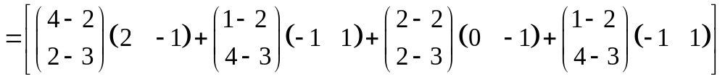
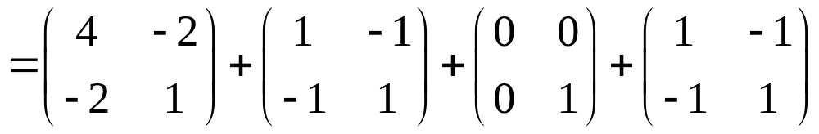
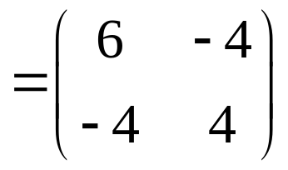
Second step: Computing the within-class scatter matrix S_{W}
Sample No. | 1 2 3 4 | 1 2 3
Feature 1 | 4 1 2 1 | 1 3 2
Feature 2 | 2 4 2 4 | 5 4 3
Class | 1 | 2

Slide 17
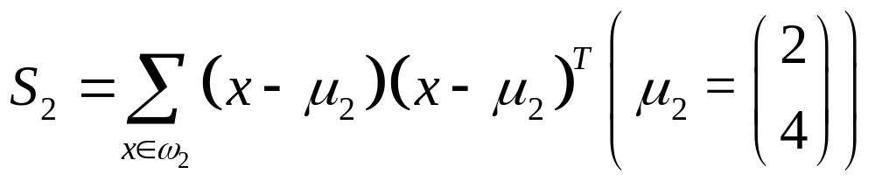
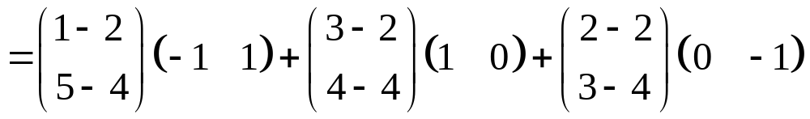
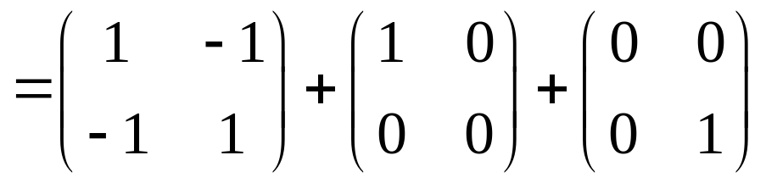
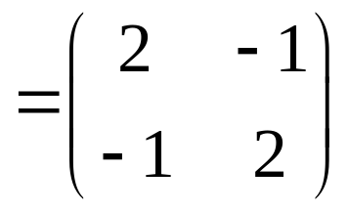
Second step: Computing the within-class scatter matrix S_{W}
Sample No. | 1 2 3 4 | 1 2 3
Feature 1 | 4 1 2 1 | 1 3 2
Feature 2 | 2 4 2 4 | 5 4 3
Class | 1 | 2

Slide 18
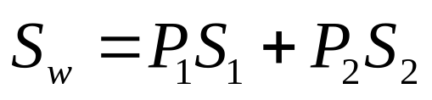
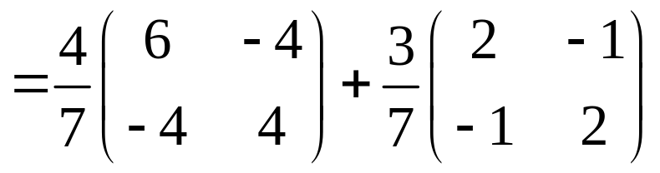
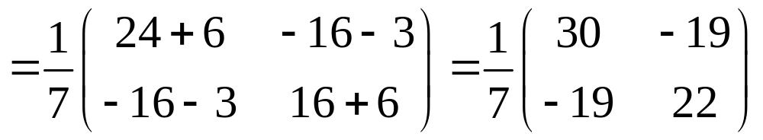
Second step: Computing the within-class scatter matrix S_{W}
Sample No. | 1 2 3 4 | 1 2 3
Feature 1 | 4 1 2 1 | 1 3 2
Feature 2 | 2 4 2 4 | 5 4 3
Class | 1 | 2

Slide 19
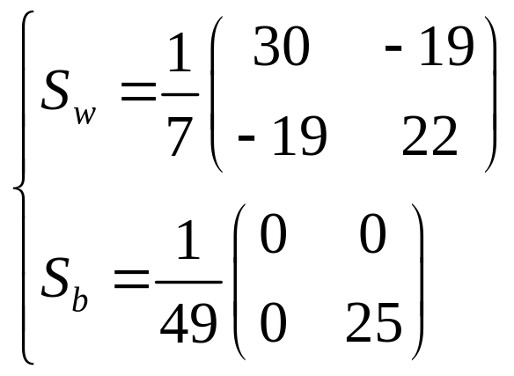
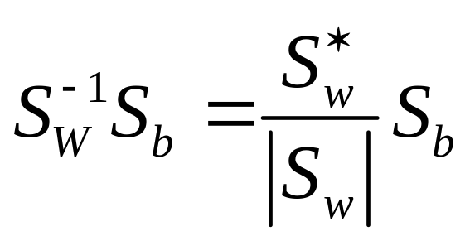
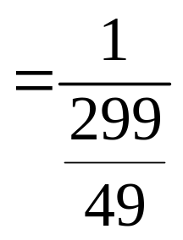
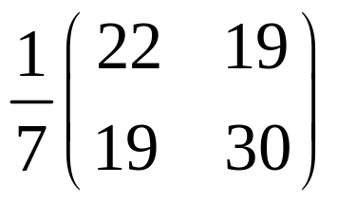
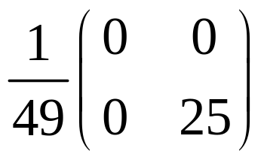
Third step: Obtaining the LAD projection
Computing S_{W}⁻¹S_{B}

Slide 20
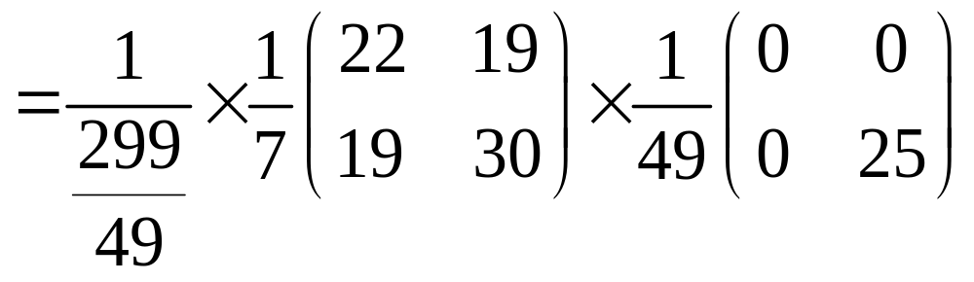
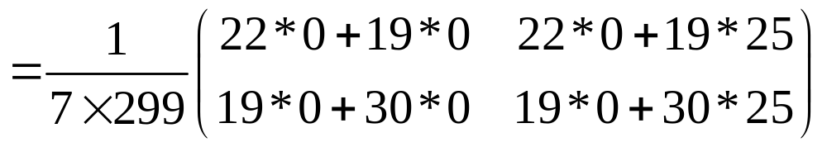
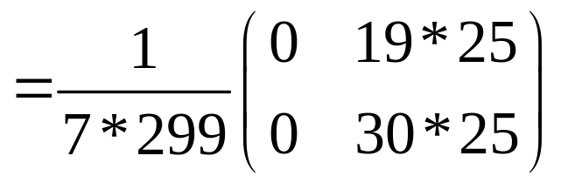
Third step: Obtaining the LAD projection
Computing S_{W}⁻¹S_{B}

Slide 21
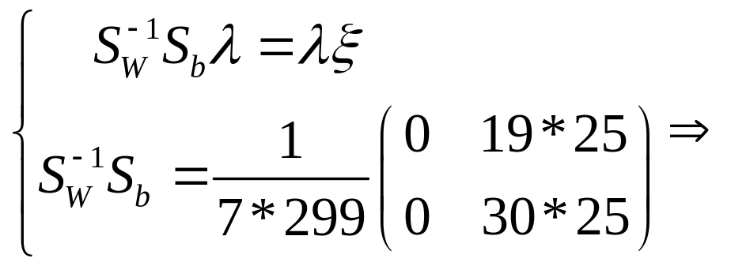
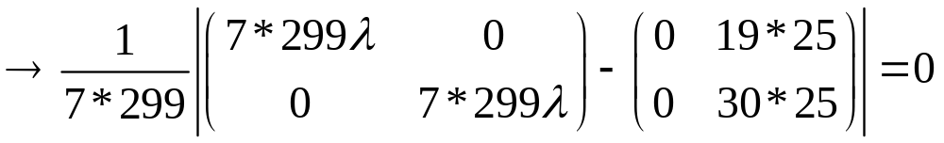
Third step: Obtaining the transformation matrix
Completing the Singular value decomposition of S_{W}⁻¹S_{B}

Slide 22
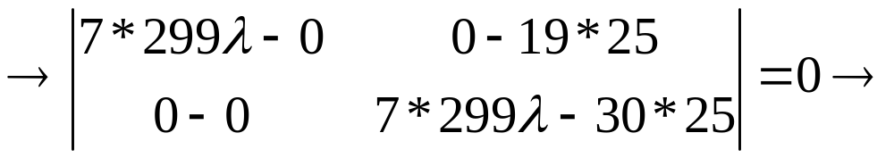
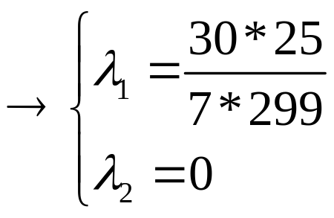
Third step: Obtaining the transformation matrix
Completing the Singular value decomposition of S_{W}⁻¹S_{B}

Slide 23
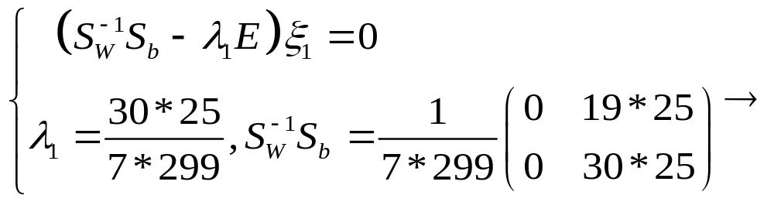
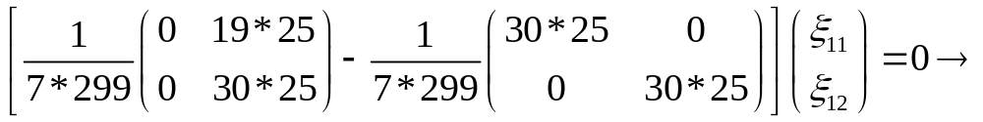
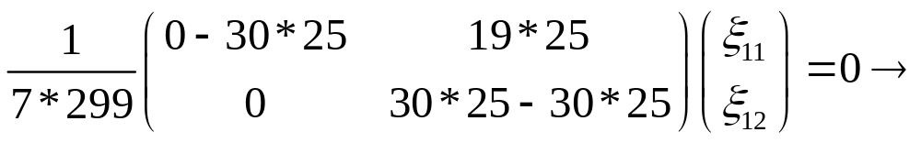
Third step: Obtaining the transformation matrix
Completing the Singular value decomposition of S_{W}⁻¹S_{B}

Slide 24


Third step: Obtaining the transformation matrix
Completing the Singular value decomposition of S_{W}⁻¹S_{B}

Slide 25



Third step: Obtaining the transformation matrix

Slide 26









Fourth step: Obtaining the LAD projection
Sample No. | 1 2 3 4 | 1 2 3
Feature 1 | 4 1 2 1 | 1 3 2
Feature 2 | 2 4 2 4 | 5 4 3
Class | 1 | 2

Slide 27







Fourth step: Obtaining the LAD projection
Sample No. | 1 2 3 4 | 1 2 3
Feature 1 | 4 1 2 1 | 1 3 2
Feature 2 | 2 4 2 4 | 5 4 3
Class | 1 | 2

Slide 28
4.3 Example of Linear Discriminant Analysis
Compute the Linear Discriminant projection for the following two-dimensional dataset.
Sample No. | 1 2 3 | 1 2 3
Feature 1 | 1 1 2 | -1 -1 -2
Feature 2 | 1 0 -1 | 1 0 -1
Class | 1 | 2

Slide 29






First step: Computing the mean of each class

Slide 30



First step: Computing the mean of each class

